Slide 1
ABC pharmaceuticals projects
Week 8: SQL Data Analysis

Slide 2
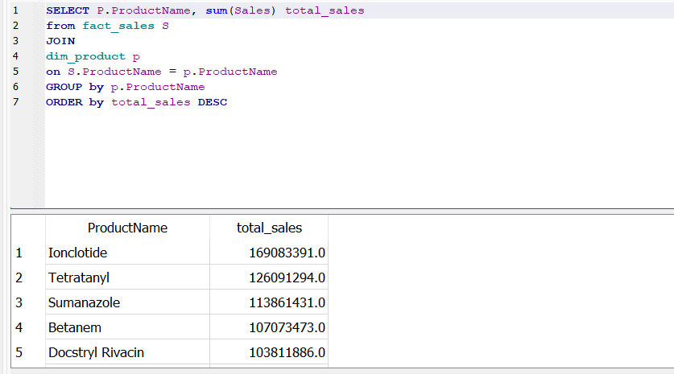
1. Sales Performance Analysis
What are the total sales for each product? (Identify the top-selling products)

Slide 3
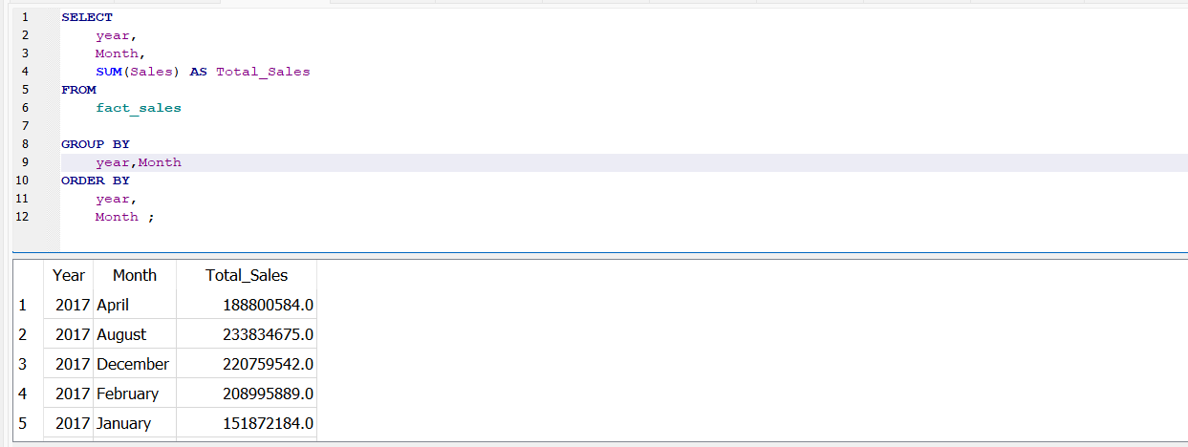
1. Sales Performance Analysis
How do sales vary month by month within a specific year? (Analyze monthly sales trends)

Slide 4
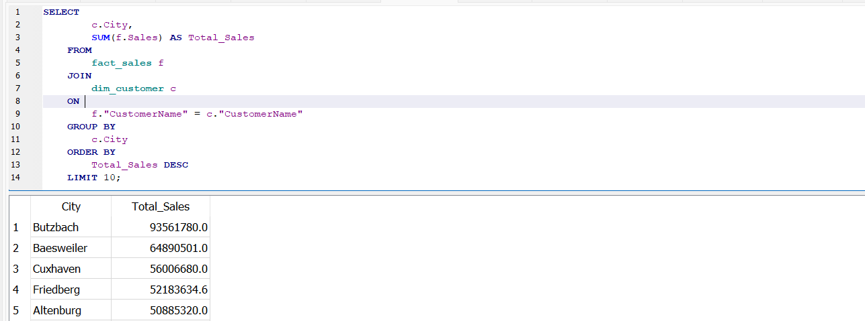
2. Sales by Location
Which cities have the highest total sales? (Identify top cities by sales volume)

Slide 5
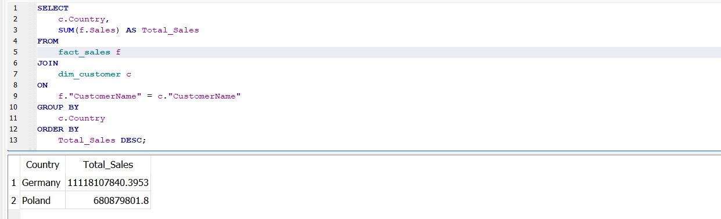
2. Sales by Location
• How do sales compare across different countries? (Analyze sales performance by country)

Slide 6
3.Customer Segmentation
• What is the total sales by customer type (e.g., Hospitals, Pharmacies)?

Slide 7
3.Customer Segmentation
• How do sales differ across various sectors (e.g., Government vs. Private buyers)?

Slide 8
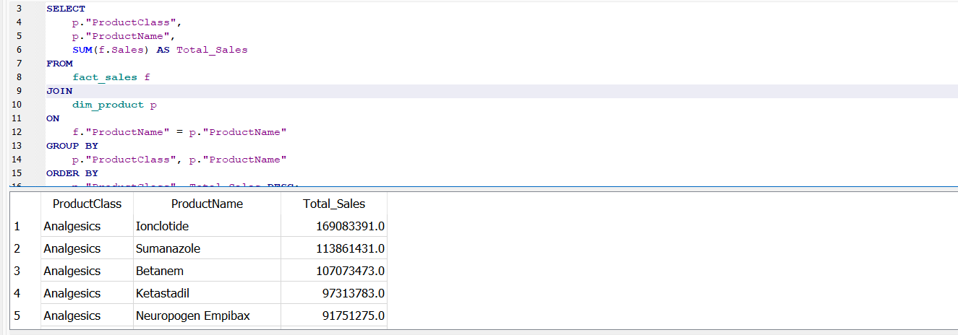
4.Product Analysis
• What are the top-selling products within each drug class?

Slide 9
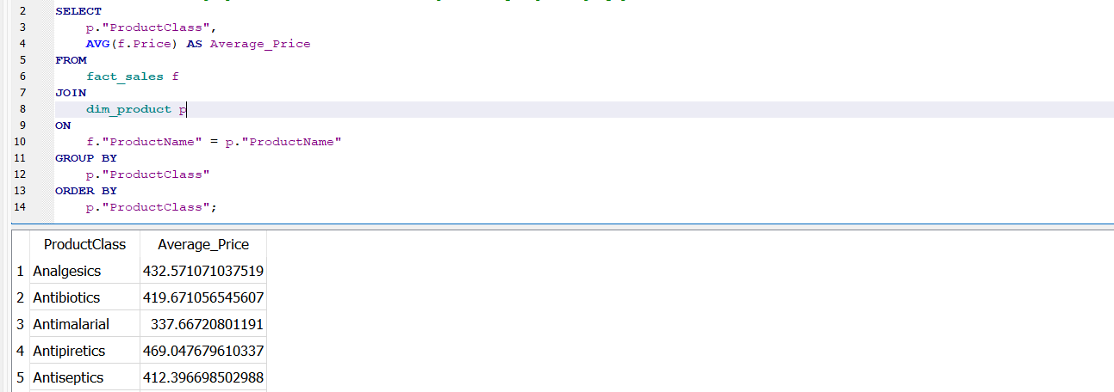
4.Product Analysis
• What is the average price for each class of drugs? (Analyze pricing by product class)

Slide 10
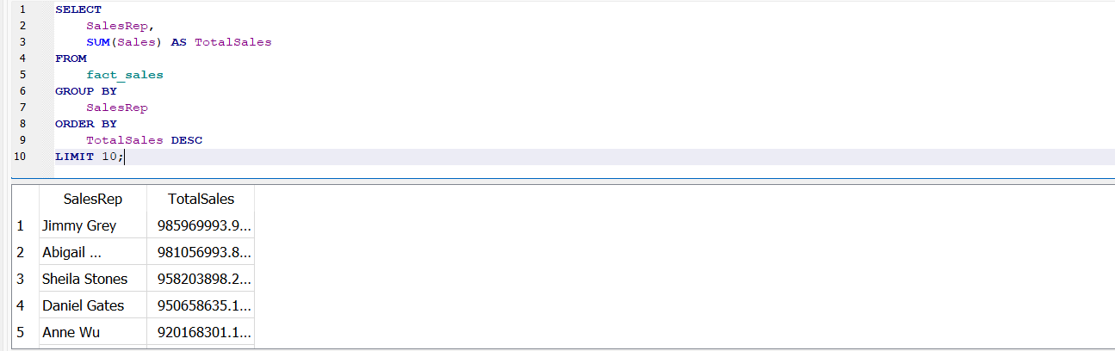
5. Sales Representative Performance
• Who are the top-performing sales representatives based on total sales?

Slide 11
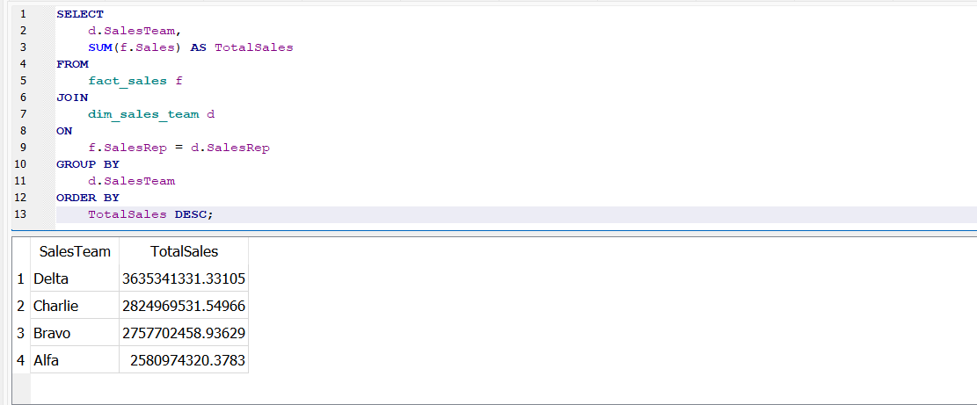
5. Sales Representative Performance
• How does sales performance vary across different sales teams?

Slide 12
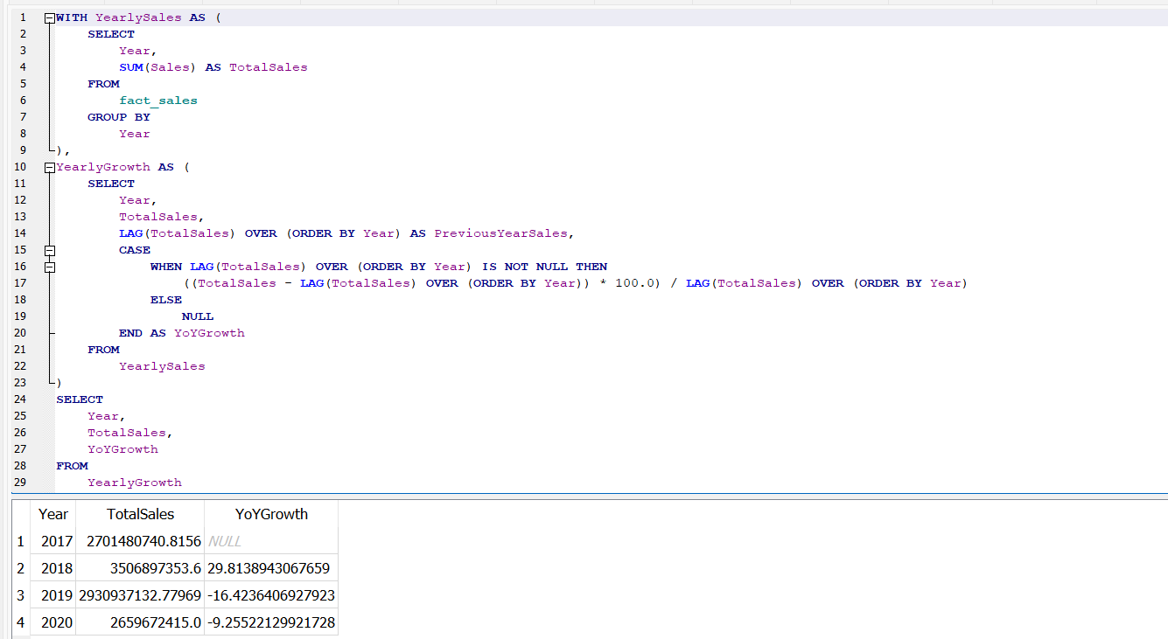
6. Time Series Analysis
• What is the year-over-year growth in total sales? (Measure growth trends over the years)

Slide 13
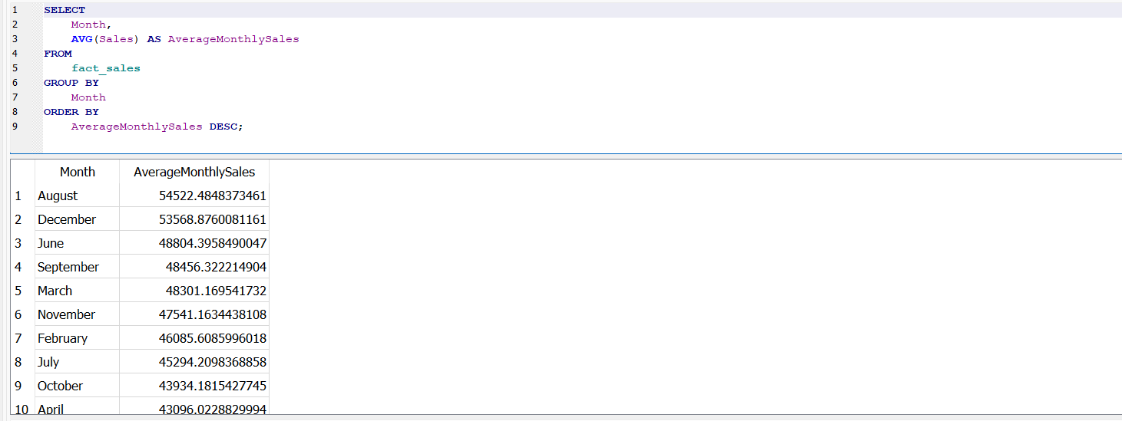
6. Time Series Analysis
• Which months consistently have the highest sales volume? (Identify seasonal sales patterns)

